Slide 1
FORMULA 1
Team Success Factors & Social Network
MSBA -11A
Angel Sheu, Chun Hui Tsai, Davidson Rajashekar, Jinyi Liu, Lalitha Bhupalam
https://www.plantillaspower-point.com
Notes:
Good morning, everyone. Today, I'm here to share with you our project on understanding success in Formula 1 from both statistical and social perspectives

Slide 2

01
Introduction
Agenda
02
Exploratory Data Analysis
03
Major Success Factors- Logistic Regression
04
Network Analysis
05
Conclusion
Notes:
This is a brief overview of what we will be covering today.

Slide 3
01
Introduction

Slide 4

Background
Premier international racing for open-wheel, single-seater cars
Listed as the “most valuable sports empire” in the world by Forbes
Formula One Group market cap: $16.54 Billion
Formula 1
Objective
Uncover performance trends across year 2010~2023
Reveal the complex web of relationships and strategies
Capture the essence of key success factors
Notes:
Formula 1, often referred to as F1, is the highest class of international auto racing.. It’s listed as the most valuable sports empire in the world with a market cap of 16.54 billion.
Now, you might be wondering, what motivated us to undertake this project? With the recent bombshell that Lewis Hamilton, one of the greatest drivers of all time, was making the switch from Mercedes to Ferrari, we were curious as what factors contribute to success in F1? Do teams really matter that much? What else matters?
From a statistical perspective, we're interested in identifying the key variables that correlate with race performance.. But beyond the numbers, we also want to explore the social dynamics at play and reveal the complex web of relationships and strategies that lie behind the scenes.

Slide 5

Data
Source: Kaggle
Size: 5757 rows
Key variables:
Year (2010~2023)
Race
Constructor
Driver
Nationality
Position Order
Championship Standing
Points
Grid
Laps
Pit Stop Time
Qualifying Time
Notes:
Onto our data. Our dataset was sourced from Kaggle and. It comprises historical Formula 1 racing data spanning from the inception of the championship in 1950 to the present day. However, for the purposes of our analysis, we narrowed our focus to data from 2010 onwards. This decision was driven by the fact that 2010 was the year when the points system became consistent and synonymous with the one we recognize today. By concentrating on this period, we ensure consistency and relevance in our analysis, allowing us to draw meaningful insights.

Slide 6
02
Exploratory Data Analysis
Notes:
We wanted to explore a variety of factors in our analysis so we conducted EDA to uncover some interesting big picture insights.

Slide 7
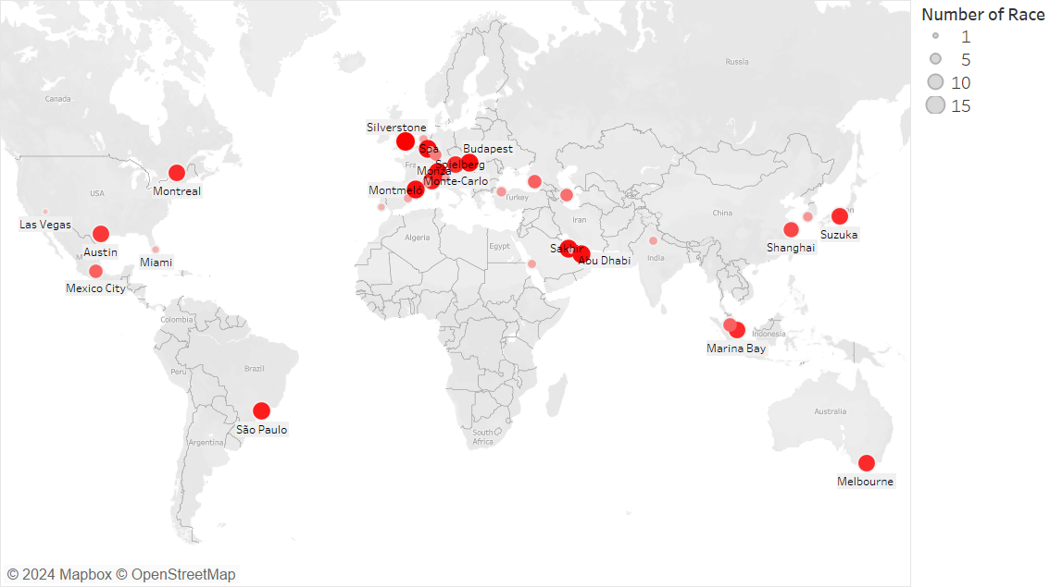
Notes:
This is an overview of the number of races held in the cites through 2010~2023. Since 2010, Formula 1 races have been held in various cities around the world, but some cities stand out as particularly popular destinations for these events. Among the most notable are cities like Melbourne, Australia, Montreal, Abu Dhabi, Monaco and Singapore.

Slide 8
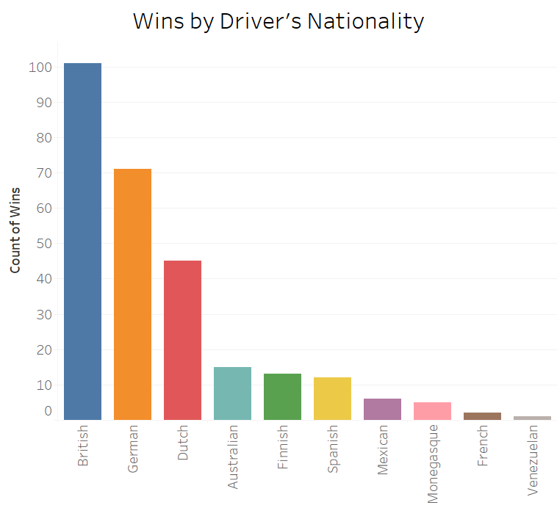
Notes:
Following on from the cities the races were in, we wanted to look at the different spread of nationalities and countries the drivers who won were from. As can be seen, Hamilton’s dominance in the 2010s means that the British lead the way but the German drivers like Vettel and Rosberg also hold their ground. We were interested in seeing if there was a correlation between a driver’s nationality and winning so we conducted a chi squared test from which we derive that there was a significant association between the two and we will explore this further later in our network analysis.

Slide 9
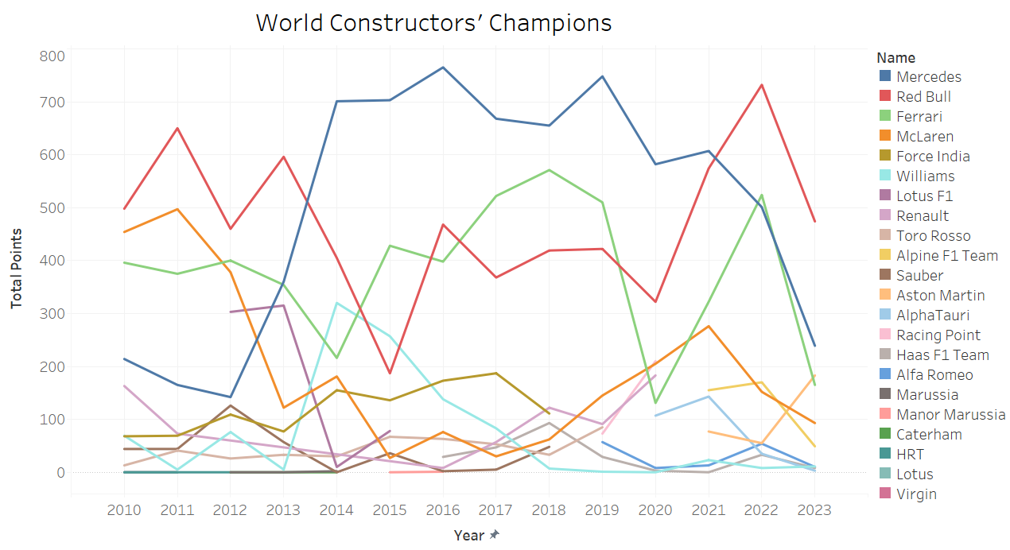
Notes:
In terms of the teams that have dominated in recent years, Mercedes and Red Bull stand out as the clear giants of the sport with Ferrari battling away in third.

Slide 10
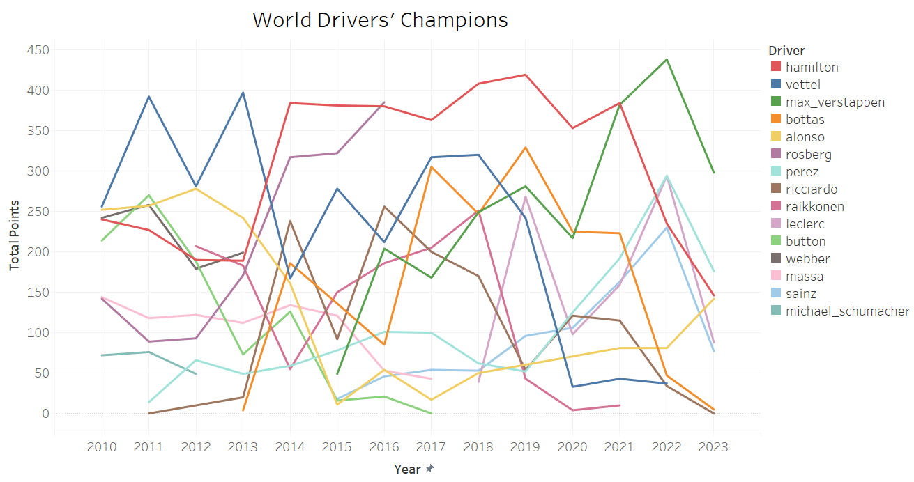
Notes:
As mentioned earlier, Lewis Hamilton has dominated Formula 1 with Mercedes, while Max Verstappen’s recent emergence has made significant waves in the world of F1.

Slide 11
03
Major Success Factors- Logistic and Linear Regression
Notes:
Now, what drives these drivers to championships and wins? We’ll first look at two regression models to see which variables are significant from a more race oriented perspective followed by some network analysis to delve into the complexities of relationships held by drivers and teams.

Slide 12
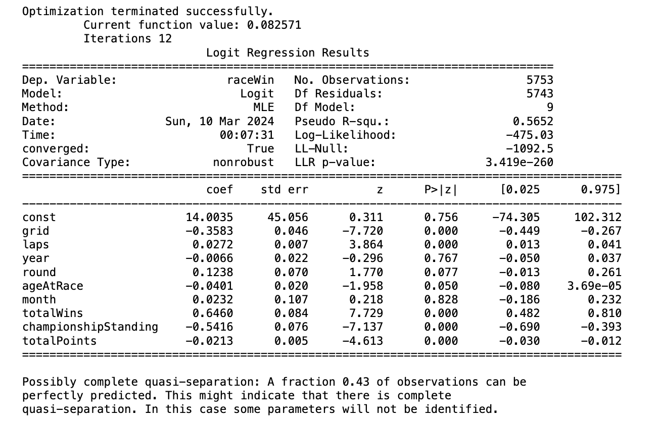
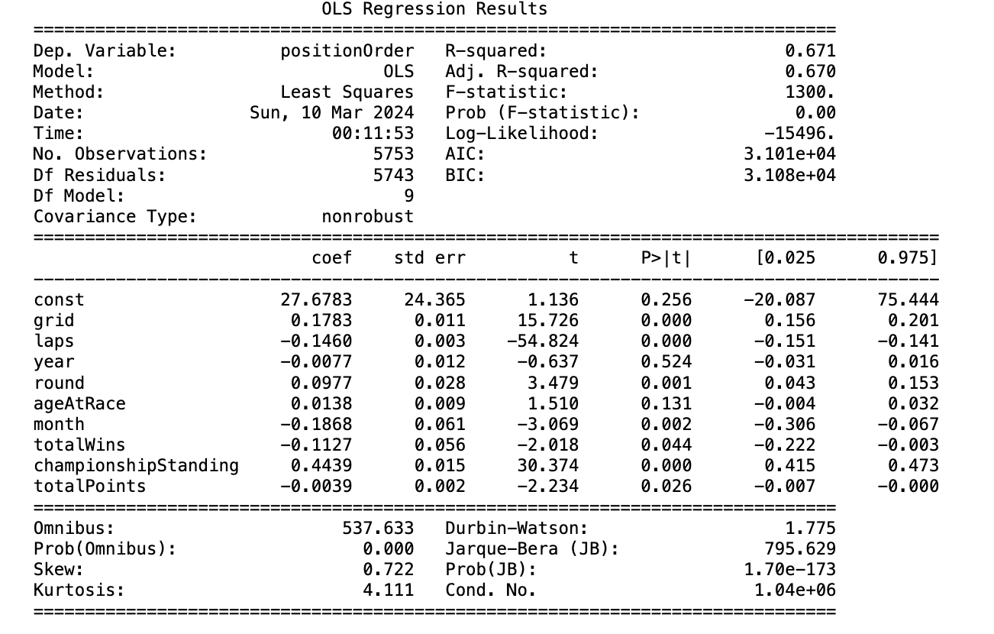
Logistic Regression
Linear Regression
Binary variable: Race won or lost
Variable: Position in race
Independent variables:
grid : position they started the race
totalPoints: points they accrued in that year's championship
laps: laps in that race
year: year of the race
round: which round (i.e which week of racing was it)
ageAtRace: age at race
month: which month (whether time of year has an effect)
totalwins: totalwins accrued in that year
championshipstanding: where they finished in the standings
Independent variables:
grid : position they started the race
totalPoints: points they accrued in that year's championship
laps: laps in that race
year: year of the race
round: which round (i.e which week of racing was it)
ageAtRace: age at race
month: which month (whether time of year has an effect)
totalwins: totalwins accrued in that year
championshipstanding: where they finished in the standings
Binary Outcome
Continuous Variable
Predicting whether they win or not
Predicting the race position
Significant Variables
Significant Variables
Grid position, laps in the race, total wins, standing and points
Grid position, laps in the race, month, round, standing and points
Metrics
High accuracy and AUC-ROC score (>95%), however inherent imbalance in dataset
Metrics
R squared = 0.67, statistically significant, model explains 67% of variability
Notes:
From the significant variables from the logistic regression analysis, we can infer that drivers who start with better grid positions, have a history of winning races, hold higher championship standings, and accumulate more points throughout the season are more likely to win races. On the other hand, the linear regression analysis reveals that the number of laps in the race, the round and month of the race are also significant predictors of finishing position. Both indicate that similar factors influence both winning races and achieving higher finishing positions, emphasizing their importance in overall race performance. While both models seem to perform well, , it's essential to acknowledge their limitations. Logistic regression oversimplifies the complex dynamics of F1 to a simple win loss scenario and linear regression may not capture the nonlinearities present in race dynamics. . Despite these limitations, both models provide valuable insights into the sport, allowing teams to make data-driven decisions and improve their performance strategies which we will dive into later. Now, Angel will move on to our network analysis,

Slide 13
04
Network Analysis
Notes:
Now, let’s dive into the social network in Formula 1 industry.

Slide 14
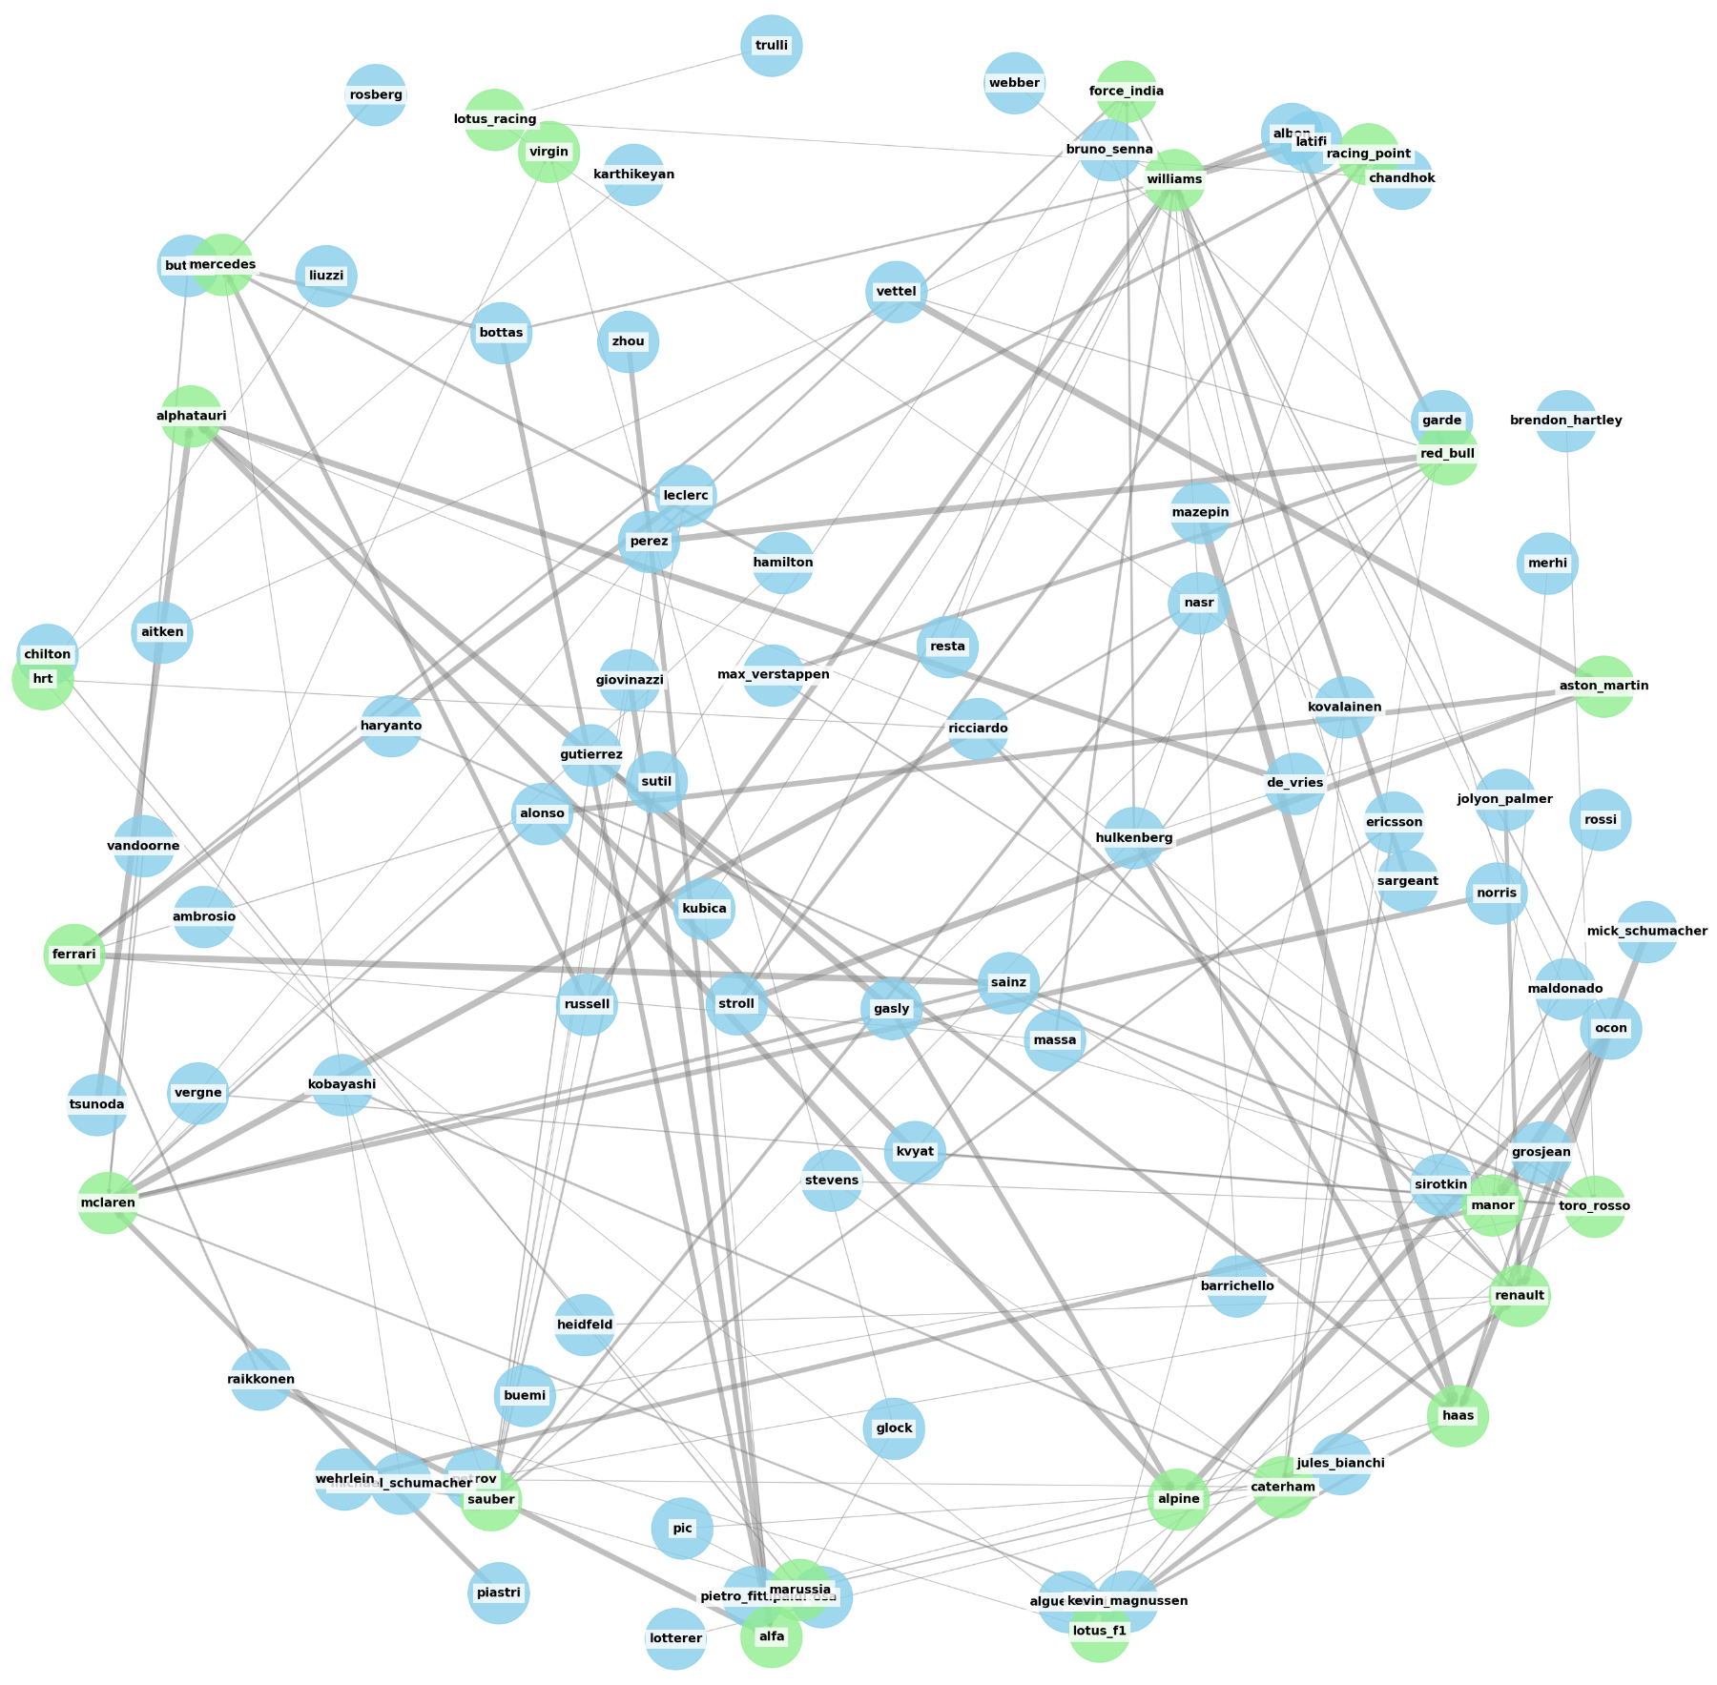
Pitstops performance Network
in Formula 1:
Insights from Avg Pitstop duration
Williams team has the fastest pitstops
Constructors in the mid level and lower level tend to focus on improving pitstop time to go higher in the rankings
Constructors with top performing cars tend to have more leniency in pitstop time since they are good with race speed
Notes:
The average pitstop time connect to drivers and constructors, and the thicker the edge means they have longer pitstop time. From the network we can see that Williams has the fastest pitstop. Mid and low-level constructors tend to improve their pitstop time in order to increase their ranking.

Slide 15
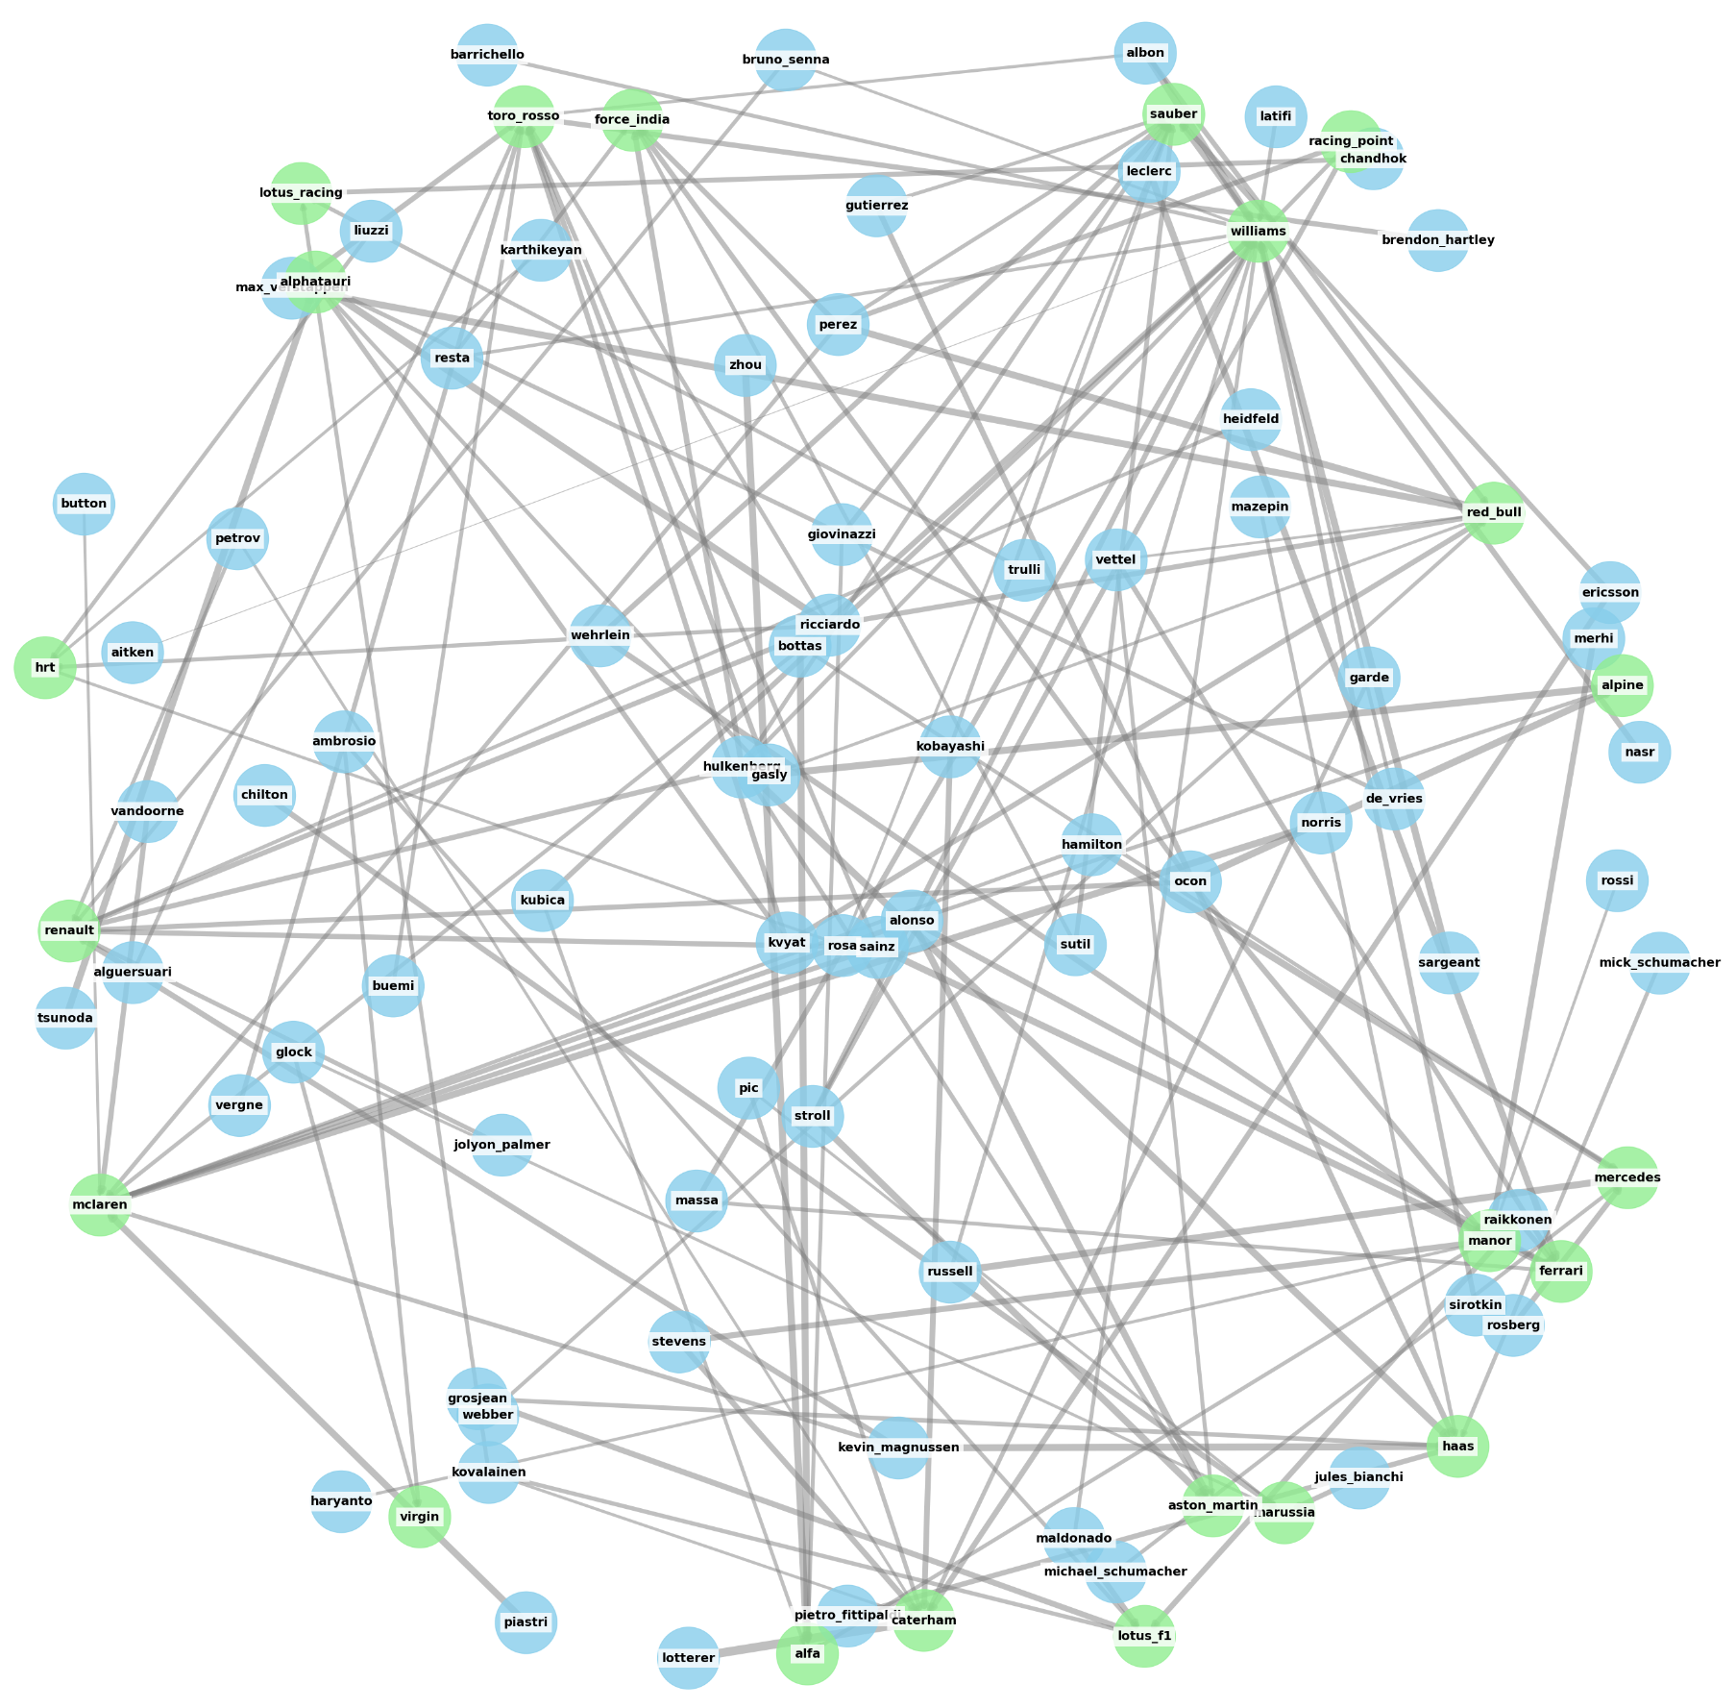
Qualifying times Network in Formula 1:
Insights from Avg qualifying times
Lower order teams like Williams, Alfa Tauri, Torro Rosso etc have higher average qualifying times
Although the top teams have lesser average qualifying times, sometimes they do have issues which increases their average
Qualifying race requires a lot of collaboration with team to ensure less times and getting ahead in the order
Notes:
Qualifying time :
From the qualifying race social network, the thicker the edge means they have longer qualifying time. Obviously, the lower order of teams like Williams, Alfa Tauri, Torro Rosso have higher average qualifying times.

Slide 16
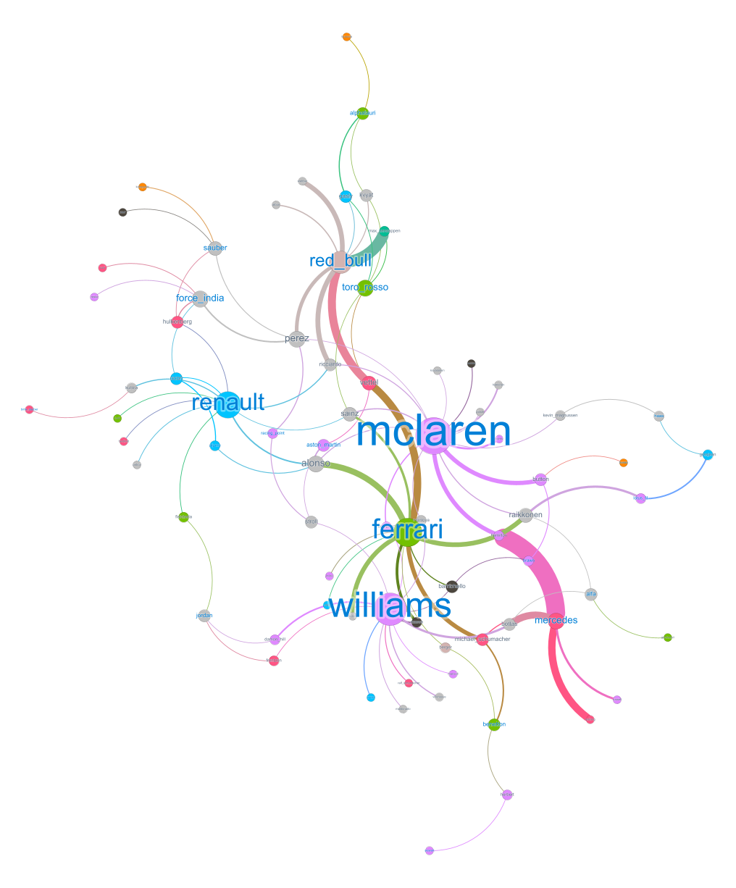

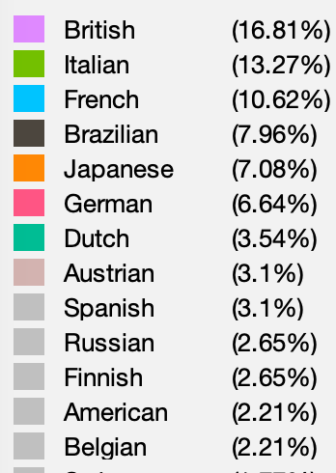
Top 5 Finishers' Network in Formula 1:
Drivers and Constructors' Performance Since 2010
Font color:
Node color:
Visual representation of top 5 winning race of relationships between drivers and teams
Node Colors represent national diversity; edges weight signify driver points in top finishes.
Node size reflects degree centrality, showing influence and prominence
Thick edges denote strong performance and collaboration between drivers and teams:Ferrari, Mercedes, and Red_bull
Diverse teams include Ferrari, Red Bull, Renault
Notably British: McLaren Notably German: Mercedes
Notes:
we want to know the top 5 winnings between drivers and teams. In this social network, nodes represent driver and teams, node’s color means nationality. Node size means they’re more centered; in other words, the driver or the constructor has more top 5 wins. Also, we highlight the weight of the edge to represents the points in a race. The thicker the edge, the higher the prize they win.
What insights can we draw from the network? Ferrari, Mercedes, and Red_bull have a good collaboration with drivers; they all get a thick edge, which means the collaboration has a better performance in races.

Slide 17
Degree Centrality
Larger nodes can be interpreted as more central or influential entities in the F1 network, indicating either consistently high-performing drivers or teams with multiple successful drivers.
Team
McLaren 0.093
Red_bull 0.082
Renault 0.072
Ferrari 0.061
Mercedes 0.051
Force_india 0.052
Williams 0.052
Driver
Perez 0.052
Alonso 0.041
Sainz 0.041
*Due to year filtering, our social network outcome differs from the online world championship ranking.*
Notes:
Which team or driver is more centered? That is to say, who gets more top 5 winning in the games? From the degree centrality, the top 3 constructors are Mclaren, Red_bull, and Renault. The Top 3 drivers are Perize, Alonso, and Sainz. It’s quite different from the ranking of championship because the centrality depends on the number of top 5 wins, not only the first prize.

Slide 18
05
Conclusion

Slide 19
Formula 1 industry
Formula 1 successful factors
The analysis suggests that drivers who start with better grid positions, have a history of winning races, hold higher championship standings, and accumulate more points throughout the season are more likely to win races.
PItstop and qualifying strategy
Pitstops are more important for lower order teams to make up times slightly.Williams has fastest pitstop.
Average qualifying times for lower order teams are higher. So increased collaboration during qualifying can result in better outcomes for the result finish.
Top 5 winning social network
Ferrari, Mercedes, and Red Bull teams typically achieve more high-quality victories in competitions.
McLaren and Renault have won more races than the other teams in the top 5, indicating potential success in the future season.
Notes:
Here are three takeaways you can get from our Formula 1 analysis:
1.The success factors of winning races include drivers who start with better grid positions, have a history of winning races, hold higher championship standings, and accumulate more points throughout the season.
2.Lower or mid-level constructors should focus more on improving their pitstop and qualifying time.
3.Regarding the Top five winning network, Ferrari, Mercedes, and Red Bull teams typically achieve more high-quality victories in competitions.
McLaren and Renault have won more races than the other teams in the top 5, indicating potential success in the future.

Slide 20


THANK YOU
Formula1 team Success Factors & Social Network
Any questions?

